Slide 1
Study logo
Study title Newsletter
Month
Background in the colour of the study
A thank you message for the sites continuing support
Any amendments or changes to the protocol.
Anything sites need to know.
Can include general progress highlighting any milestones or good things we have seen.
If you need the sites to do anything this can be addressed e.g reminder to add blood results or send samples.
Share any website links or media engagement
Upcoming Meetings/Events
Useful tips, FAQs and reminders – tips from other sites are great! Caring is sharing
Let sites know of any new promotional material
CRF completion/queries
Meet the members of the trial team
Update
An update on where recruitment is at can include:
- % of total recruitment
How many a month
Is there is a monthly target
Recognition when sites recruit their first participant
Best recruiting sites – thank the teams that recruit the most
This can be represented as a bar chart or a line graph or a table
Can be split up between sites or months
Recruitment
Welcome
- Welcome sites as they join the study.
- A projection of new sites and what effect this will have on recruitment.
A map of where open sites are
Pictures of new teams/logos
Competitions and incentives:
Calendar - if a site recruits on certain days they get a reward
Sites get a gift when they recruit their first patient
The largest recruiter in the previous month
The site that completes data the best
Could set goals for sites to hit and rewarded
Contact Information
Study email
Study Website
Trial Manager name
TMSO name
Numbers
ECTU address
CI name
Any other relevant contact info
Logos of sponsorships and charities and university

Slide 2
Column Lay out
Study logo
Study title Newsletter
Month
Trial update
Highlights
Queries/requests
New sites
Maps
Contacts
Meet the team
Competitions
Recruitment
Graphs
Logos of sponsorships and charities and university

Slide 3
Contacts
Study logo
Row Lay out
Study title Newsletter
Month
Update:
Highlights:
Competition:
Recruitment:
Graph
Welcome to sites:
Logos of sponsorships and charities and university

Slide 4






Trial Name
IRAS PROJECT ID: 207747
Back page is next slide
LONG NAME
NEWSLETTER – MONTH YEAR ISSUE (NO.2)
STUDY NEWS
Hello from the STUDY trial management team!
REMINDERS
RECRUITMENT
TOP RECRUITER =
Congratulations everyone # is an awesome effort!
Site Name | No. Participants Randomised
FUN FACT
CONTACT INFORMATION
Chief Investigator:
Trial Manager:
Trial Management Support Officer:
Trial Mailbox:
This trial is organised by the University of Edinburgh and is funded by the UK National Institute for Health Research (NIHR) Efficacy and Mechanism Evaluation Programme.

Slide 5
IRAS PROJECT ID:
IRAS PROJECT ID: 207747
FAQ'S
THANK YOU FOR YOUR CONTINUED HARD WORK!
IF YOU HAVE ANYTHING THAT YOU WOULD LIKE FEATURED OR SHARED IN OUR NEXT NEWSLETTER PLEASE GET IN TOUCH
This trial is organised by the University of Edinburgh and is funded by the UK National Institute for Health Research (NIHR) Efficacy and Mechanism Evaluation Programme.

Slide 6
Study Logo
Back page next slide
Newsletter
Date/Issue
Urgent Reminder
Retention and adherence
Targets:
>95% retention
>90% adherence
Current performance:
93% retention
(Up 1% from August!)
93% adherence
(Up 1% from August!)
4
Trial Timeline
Emphasise key date and current progress
Trial Coordinating Centre Contact Details:
Page 1 of 2
Website:

Slide 7



Study logo
Newsletter
October 2023
Request for Site Close-out Documentation
Request for Final Invoices
Thank you for all your support during the Trial
Please do not hesitate to get in touch if you have any questions via study email
Trial Coordinating Centre Contact Details:
Page 2 of 2
Website:

Slide 8





Newsletter
Date/Issue
Study logo
Announcement
Reminder
Reminder
Study news
Important Dates
Contact us:
CI: Trial team:

Slide 9
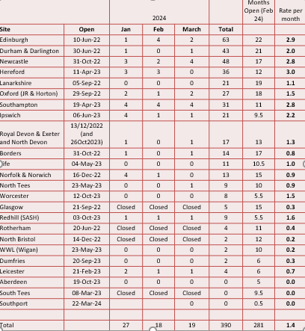



Study logo
Full Title
NEWSLETTER
Date and Issue
Back page next slide
Recruitment
Recruitment Table (up to 31st March, inclusive)
Upcoming Site Teleconferences
24th April 14:00-15:00 – link here
12th June 15:00-16:00 – link here
Key Announcement
THANK YOU FOR YOUR CONTINUED SUPPORT!

Slide 10
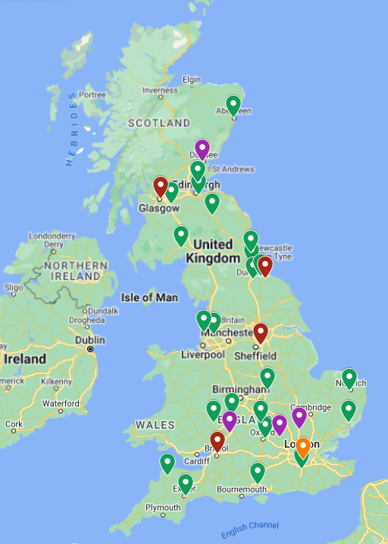


Full Title
Study Logo
NEWSLETTER
Date and Issue
Site Map
Reminders
Contact Information
Study Mailbox:
Chief Investigator:
Trial Management:
Clinical Coordinator:
Trial Website:
Trial Twitter:
Green – Open
Orange – SIV completed
Purple – SIV pending
Red – Closing

Slide 11











IRAS NUMBER: 272418
Study logo
Back page next slide
NEWSLETTER – Date/Issue
STUDY NEWS
Hello from the study Trial Office!
GET TO KNOW YOUR MARVEL COMMUNITY
Biography and picture of team member
RECRUITMENT
This trial is organised by the Edinburgh Clinical Trial Unit at the University of Edinburgh and is funded by

Slide 12

IRAS NUMBER: 272418
Study Logo
NEWSLETTER – Date/Issue
REMINDERS
11.17%
Announcement
CONTACT INFORMATION
If you have any fun news or helpful tips you would like shared in future newsletters, let us know!
Chief Investigator:
Trial Manager:
Trial Mailbox:
Website:
Twitter:
This trial is organised by the Edinburgh Clinical Trial Unit at the University of Edinburgh and is funded by the Jon Moulton Foundation.

Slide 13













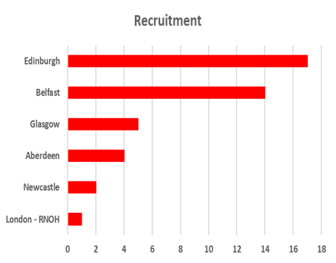
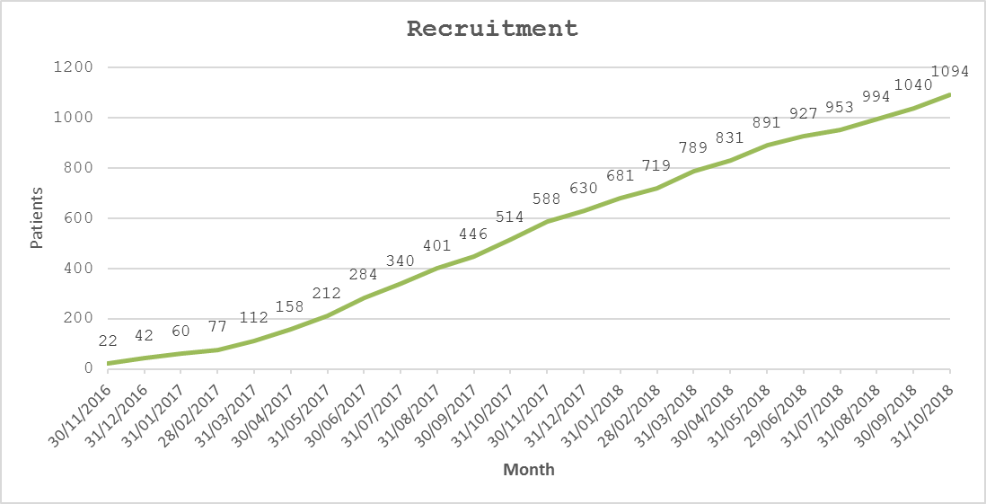

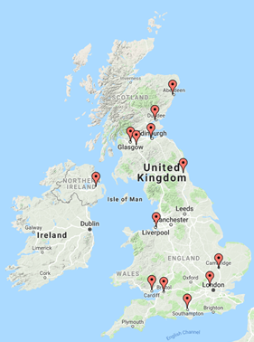



Ideas of what art/diagrams to use
Welcome and thank you:
Competitions
Recruitment graphs and maps:
Sponsorship logos
Maps can be made here -https://www.zeemaps.com/

