Slide 1

Visual frailty: Perceptions amongst eye care professionals
Godfrey Wanok
Supervisors:
Prof. Baljean Dhillon (Clinical Ophthalmology)
Prof. Ian Underwood (Electronic Displays)

Slide 2

Outline
Background
Methods
Results
Conclusion

Slide 3
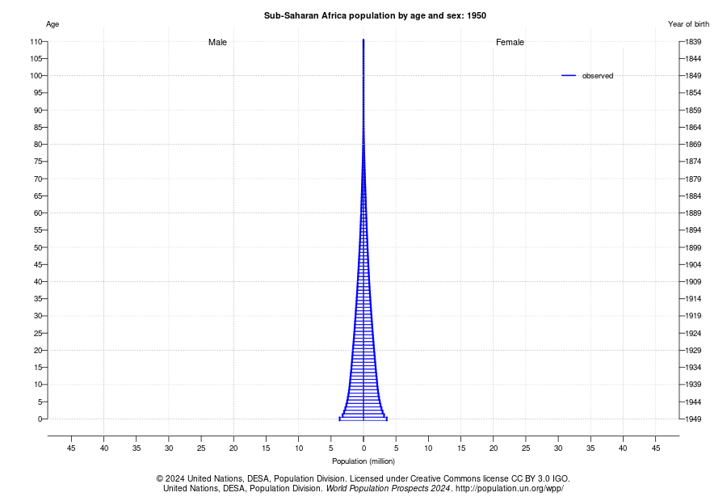
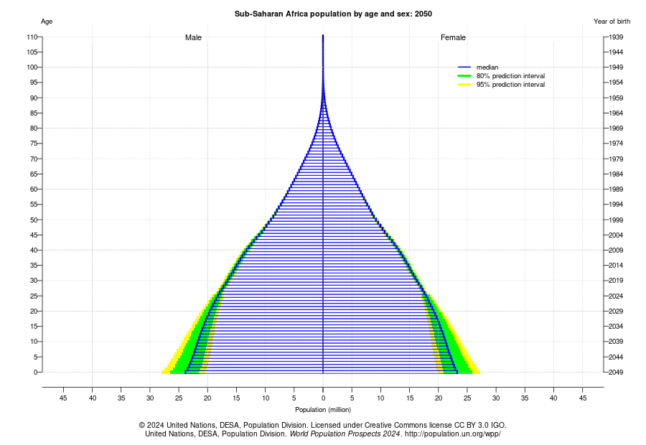
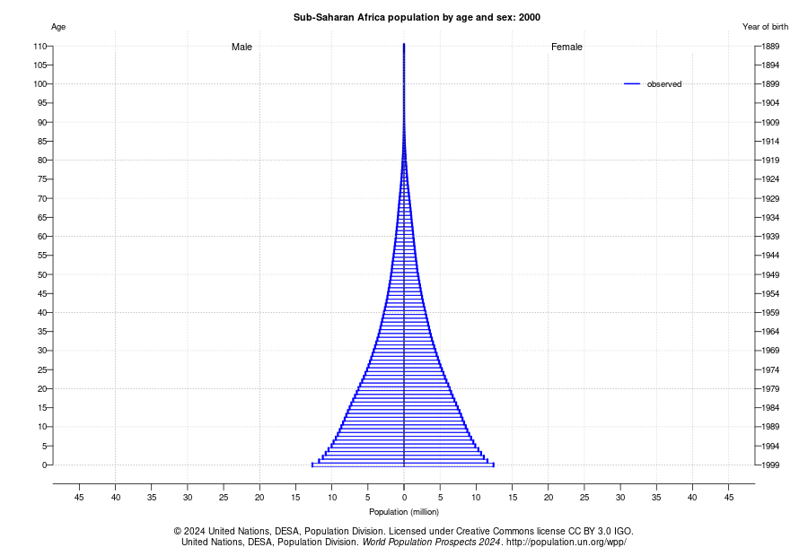
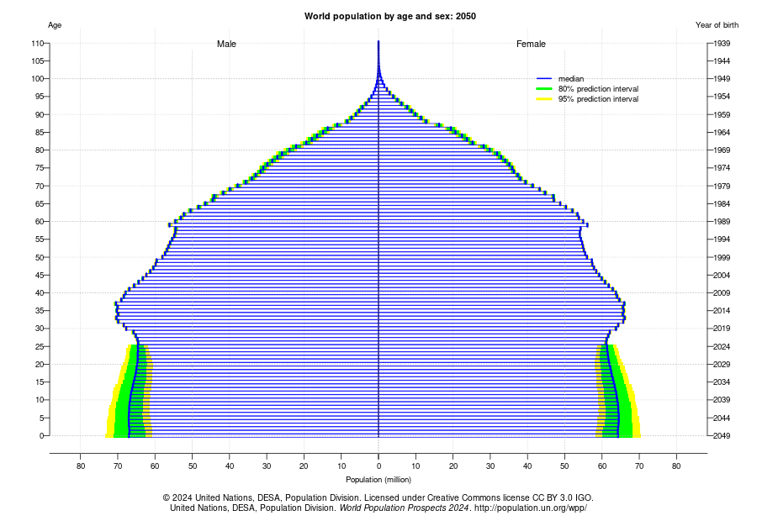
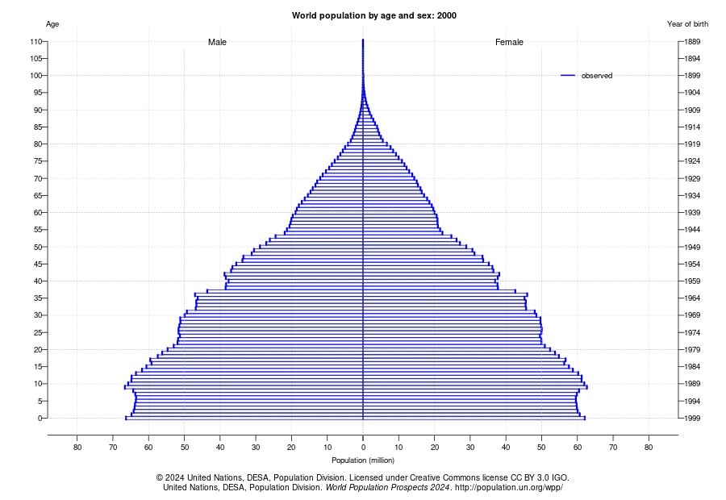
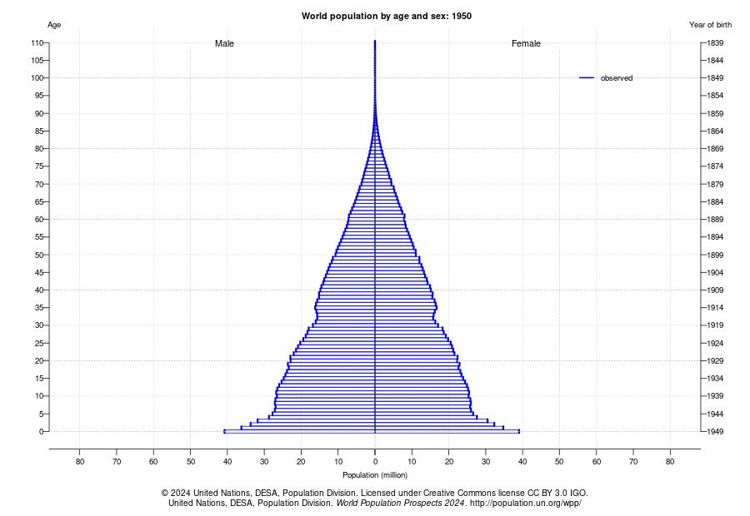
Background: The global ageing population

Slide 4
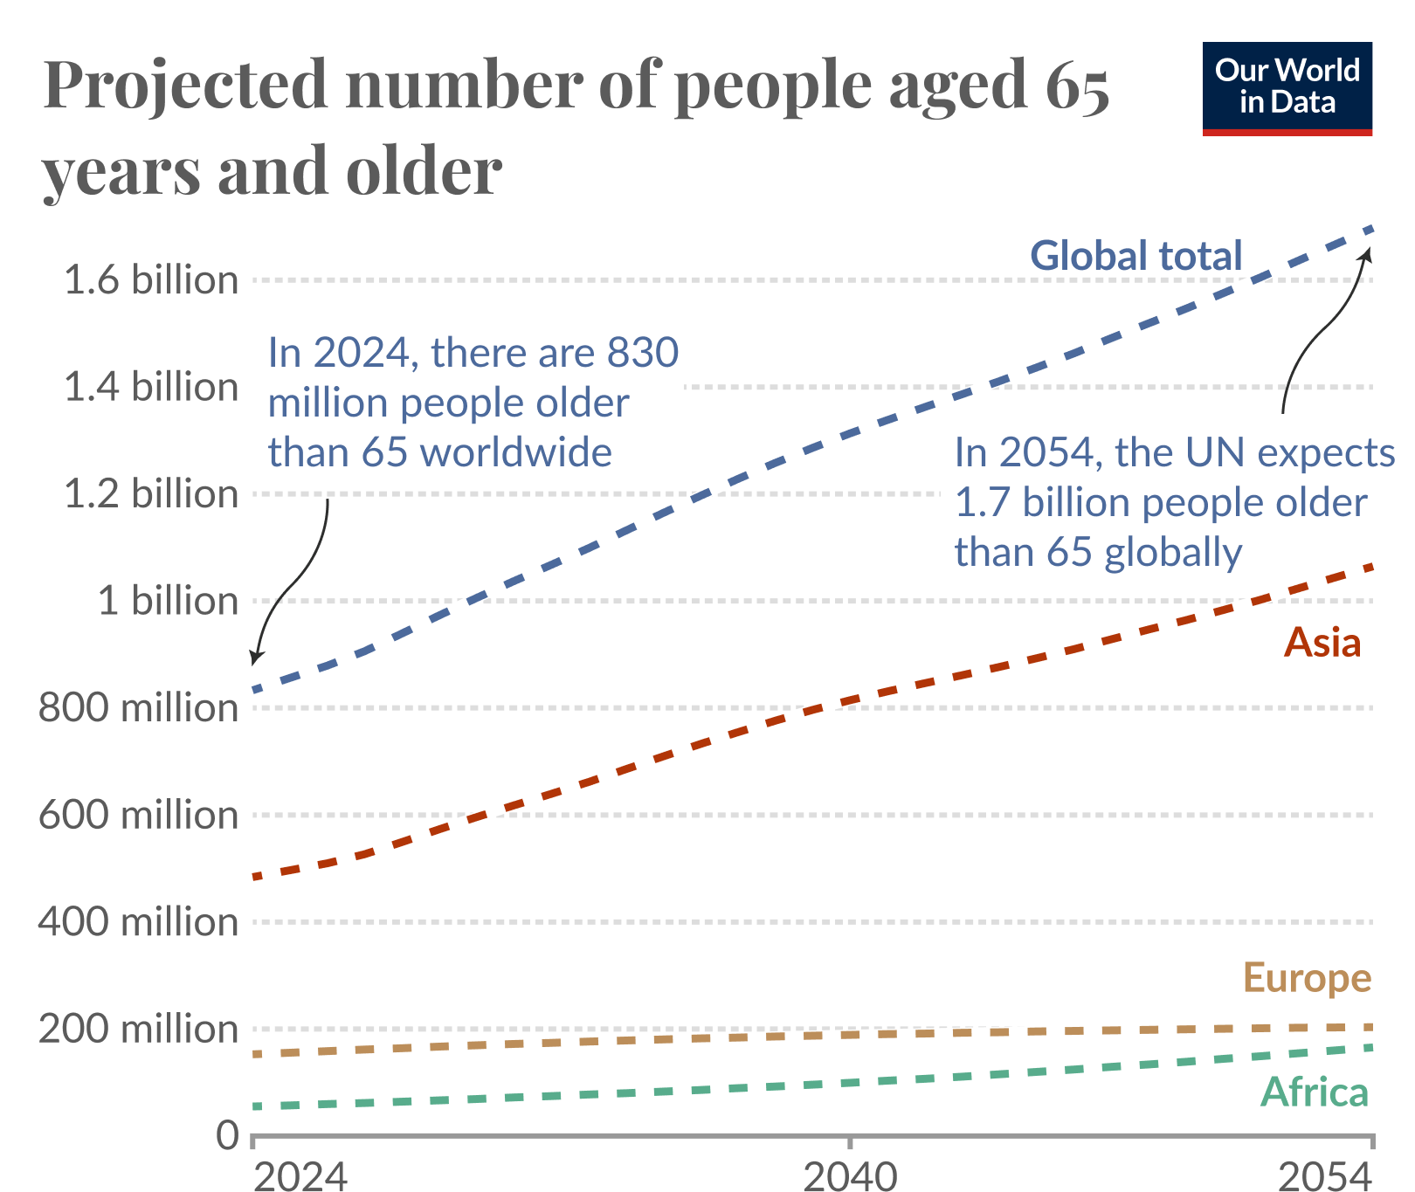
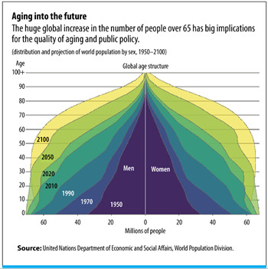
Background
Recent rapid increase in the global ageing population
The number of people aged 65 years or older worldwide is projected to more than double, rising from 761 million in 2021 to 1.6 billion in 2050 (UN, 2023)
Increase in the number of people with visual impairment, blindness, multimorbidity and frailty.
Visual frailty is an emerging concept in the field of eye care and geriatrics
Notes:
By 2050, 1 in 4 people in Europe & America will be 65 years and above
Leading to reduced quality of life
UN Report link: https://www.un.org/development/desa/dspd/wp-content/uploads/sites/22/2023/01/2023wsr-chapter1-.pdf
The number of people aged 80 years or older is growing even faster.

Slide 5
Visual frailty
A multifactorial condition that presents with reduction in visual function which can have varied impact on an individual’s functional status depending on its severity.
Other researchers referred to the concept as Eye frailty or Ocular frailty
Study aim:
To gather opinions from eye care providers to explore if the term “visual frailty” has meaning/relevance in their practice.
Notes:
With few researchers defining it differently: Itokazu and colleagues in 20XX defined it as Eye frailty while Huang et al in 2026 defined it as ocular frailty.

Slide 6
Methods
A Microsoft online survey circulated by email and on social media platforms like LinkedIn, X, Facebook, and WhatsApp from 25th August to 9th November 2025
Participants were encouraged to circulate the survey amongst their professional networks
Ethical approval was granted from the South East Scotland Research Ethics Committee 01 (REF: 24/SS/0021)
Health Research Authority (HRA) approval was also granted
Notes:
It refers to a person's mental and physical resilience, or their ability to bounce back and recover from events like illness and injury.
Vetrano, D. L., Palmer, K., Marengoni, A., Marzetti, E., Lattanzio, F., Roller-Wirnsberger, R., Lopez Samaniego, L., Rodríguez-Mañas, L., Bernabei, R., & Onder, G. (2018). Frailty and Multimorbidity: A Systematic Review and Meta-analysis. The Journals of Gerontology: Series A, 74(5), 659-666. https://doi.org/10.1093/gerona/gly110
Age UK - https://www.ageuk.org.uk/our-impact/policy-research/frailty-in-older-people/understanding-frailty/
NHS England - https://www.england.nhs.uk/blog/frailty/

Slide 7
Results
53 respondents
Survey link circulated on LinkedIn, X, Facebook, and WhatsApp groups.
45 consented
40 optometrists (97.6%)
1 ophthalmologist (2.4%)
4 participants were excluded because they were neither optometrists nor ophthalmologists.

Slide 8
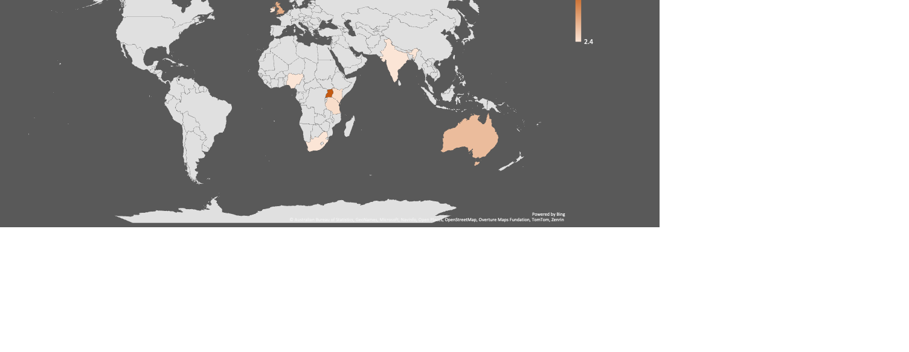
Location of respondents
Income status | Country (N=10) | Participants (N=41) n(%)
LMICs | Uganda | 18 (43.9%)
 | India | 1 (2.4%)
 | Kenya | 2 (4.9%)
 | Nigeria | 1 (2.4%)
 | Tanzania | 2 (4.9%)
 | Mauritius | 1 (2.4%)
 | South Africa | 1 (2.4%)
HICs | Australia | 6 (14.6%)
 | Ireland | 1 (2.4%)
 | UK | 8 (19.5%)

Slide 9
The concept of visual frailty
82.9% had never previously heard of the term “Visual Frailty”
Definitions by the 17.1%:
“a state in which low vision significantly increases old adults’ vulnerability to functional decline, loss of independence, and health risks”
“reduction in visual acuity recorded over a period of time”
“inability to perform simple tasks like before”
(P08, Kenya)
(P10, United Kingdom)
“Eye frailty”
“Eye deterioration due to age”
(P06, Tanzania)
(P51, Kenya)
(P25, Uganda)
Notes:
The first option can be explained differently?? Vision as a risk factor for loss of independence.. Age-related visual deterioration and and risk factor for other challenges in old age.

Slide 10
Definition of visual frailty using own words
Broad Classification | Respondents | Example of definitions
Overall visual deterioration | 34.1% | “Visual depreciation both functional and physical” (P06, Tanzania) “Difficulty in seeing and performing daily living tasks due to poor eyesight” (P21, United Kingdom)
Age related visual decline | 46.3% | “Decline in the visual function and general physical condition of the eye due to aging” (P13, Uganda) “Changes in visual function from optimum to less than optimum due to natural ageing process” (P36, Ireland)
Poor vision as a risk factor for frailty | 19.5% | “Describing patients whose vision loss is a key driver of their overall frailty” (P10, United Kingdom) “Where vision has reduced the resilience of the person and increased the risk of injury” (P32, Australia)
Notes:
From all respondents

Slide 11
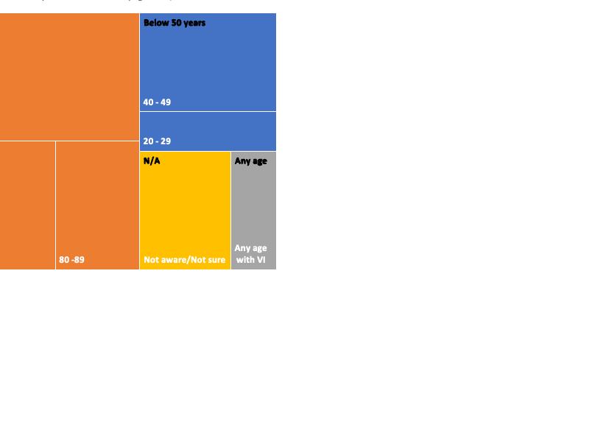
Age of patients for Visual frailty diagnosis
Notes:
Approximately 68.3% opined that visual frailty could present in individuals aged 50 years and above, 17.1% said below 50 years, 4.9% said it could occur at any age while 9.8% were not sure.

Slide 12
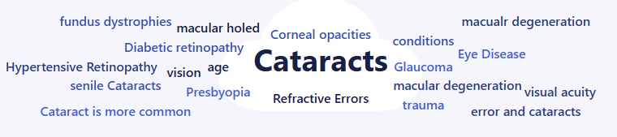
Conditions responsible for visual frailty
LMICs: Cataracts (43.9%) and AMD (23.0%)
HICs: AMD (60.0%) and Cataracts (26.7%)
Overall: Cataracts (53.7%) and AMD (43.9%)
Notes:
Considered to be the leading the cause of Visual frailty:
Yet to be found if these are considered in clinical practice

Slide 13
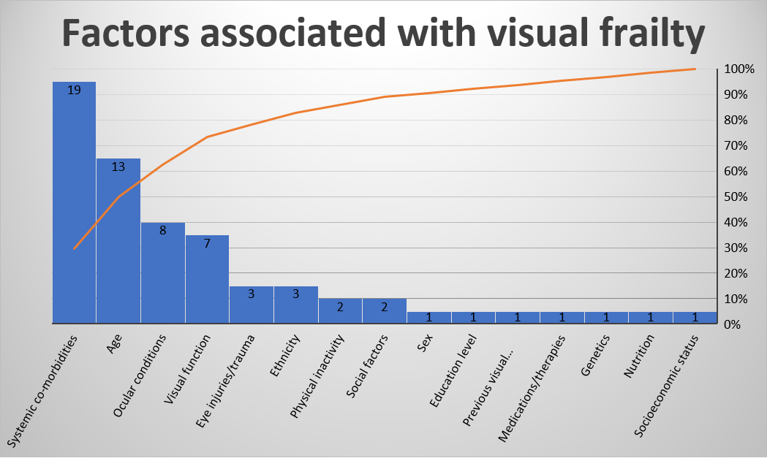
Notes:
Pareto chart – The first 70 to 80% of Visual frailty could be due to the four factors. If these factors are addressed, they could reduce on the impact of visual frailty. These same factors could be used to design a tool to measure.

Slide 14
Conclusions
Adds to our understanding of the emerging concept of visual frailty.
A minority suggest that visual frailty might occur at any age although it is most common in later life.
Defining both the concept and its assessment might prove useful in practice.

Slide 15
References
Ahmed SK, Mohammed RA, Nashwan AJ, Ibrahim RH, Abdalla AQ, M. Ameen BM, Khdhir RM. Using thematic analysis in qualitative research. Journal of Medicine, Surgery, and Public Health. 2025;6:100198.
Braun V, Clarke V. Using thematic analysis in psychology. Qualitative Research in Psychology. 2006;3(2):77-101.
Huang L, Chen A, Zhang Q, Zhu J, Cheng Y. Ocular frailty: A concept analysis. Survey of Ophthalmology. 2026. https://doi.org/10.1016/j.survophthal.2026.01.005
Itokazu M, Ishizaka M, Uchikawa Y, Takahashi Y, Niida T, Hirose T, Ito A, Yakabi A, Endo Y, Sawaya, Y, Igawa T, Kobayashi K, Hara T, Watanabe M, Kubo A, & Urano T. Relationship between Eye Frailty and Physical, Social, and Psychological/Cognitive Weaknesses among Community-Dwelling Older Adults in Japan. International Journal of Environmental Research and Public Health. 2022;19(20):13011. https://doi.org/https://dx.doi.org/10.3390/ijerph192013011
Japan Ophthalmology Awareness Council. Japan Ophthalmology Awareness Council Eye Frailty Awareness Official Website. 2021. Retrieved 2025 November 15th from https://www.eye-frail.jp
UN. World Social Report 2023: Leaving no one behind in an ageing world. 2023

Slide 16
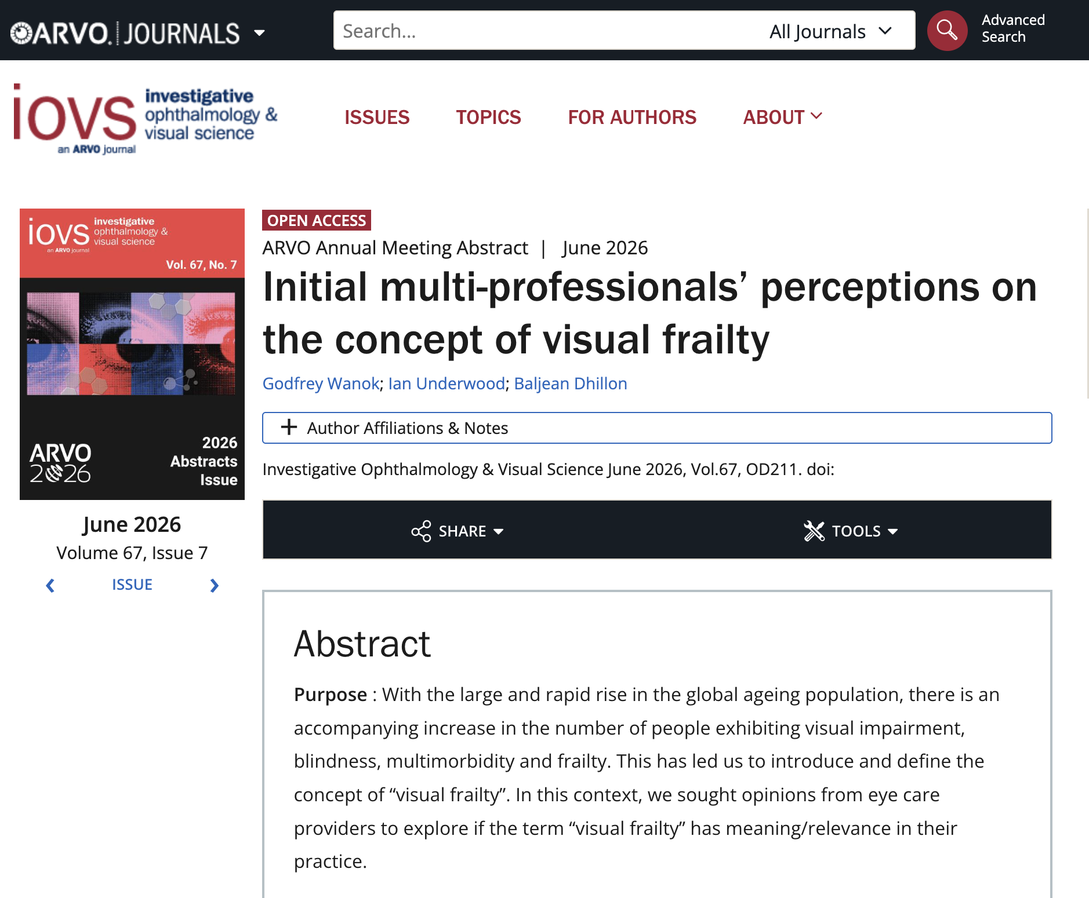
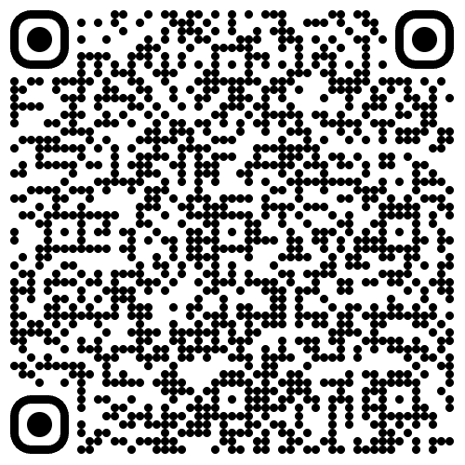
ARVO Presentation - 3rd to 7th May 2026

Slide 17
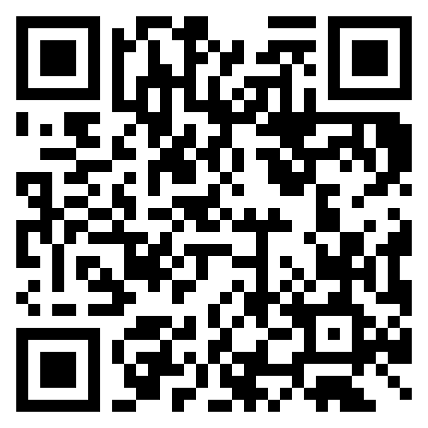
Contact details
Email: Godfrey.Wanok@ed.ac.uk
LinkedIn: http://linkedin.com/in/wanok-godfrey

Slide 18


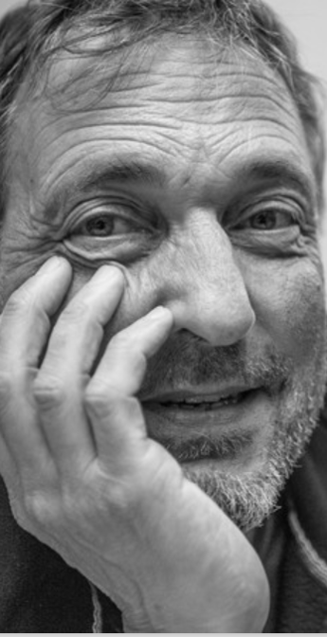
Vision
THANK YOU
This PhD project is funded by the Legal & General Group (research grant to establish the independent Advanced Care Research Centre at the University of Edinburgh)

